Slide 1

Data Stream Mining
Lesson 1
Bernhard Pfahringer
University of Waikato, New Zealand
1
Notes:
1

Slide 2
Or:
Why YOU should care about Stream Mining
2
Notes:
2

Slide 3
Overview
Why is stream mining important?
How is it different from batch ML?
Five Commandments
IID assumption
Standard algorithmic approaches
Everything is an approximation
Counting in log N bits
MinSketch
SpaceSaving

Slide 4
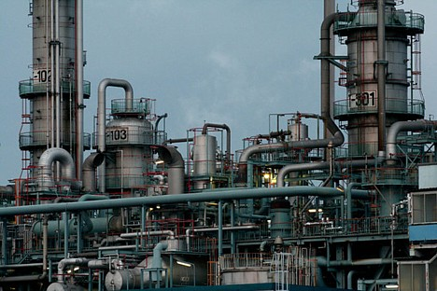
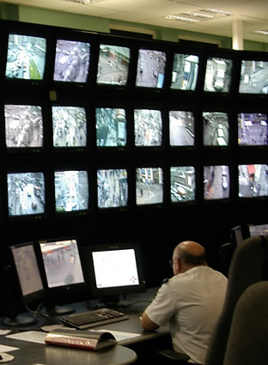
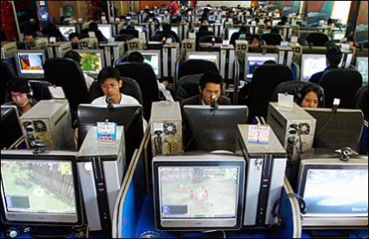
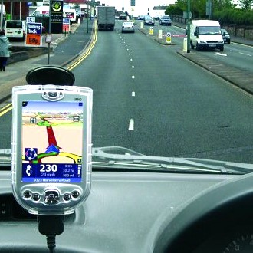


Data streams are everywhere
Sensor data
Web data (logs,content)
Activity data

Slide 5
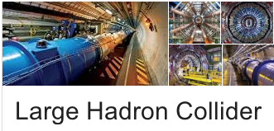

Science streams

Slide 6
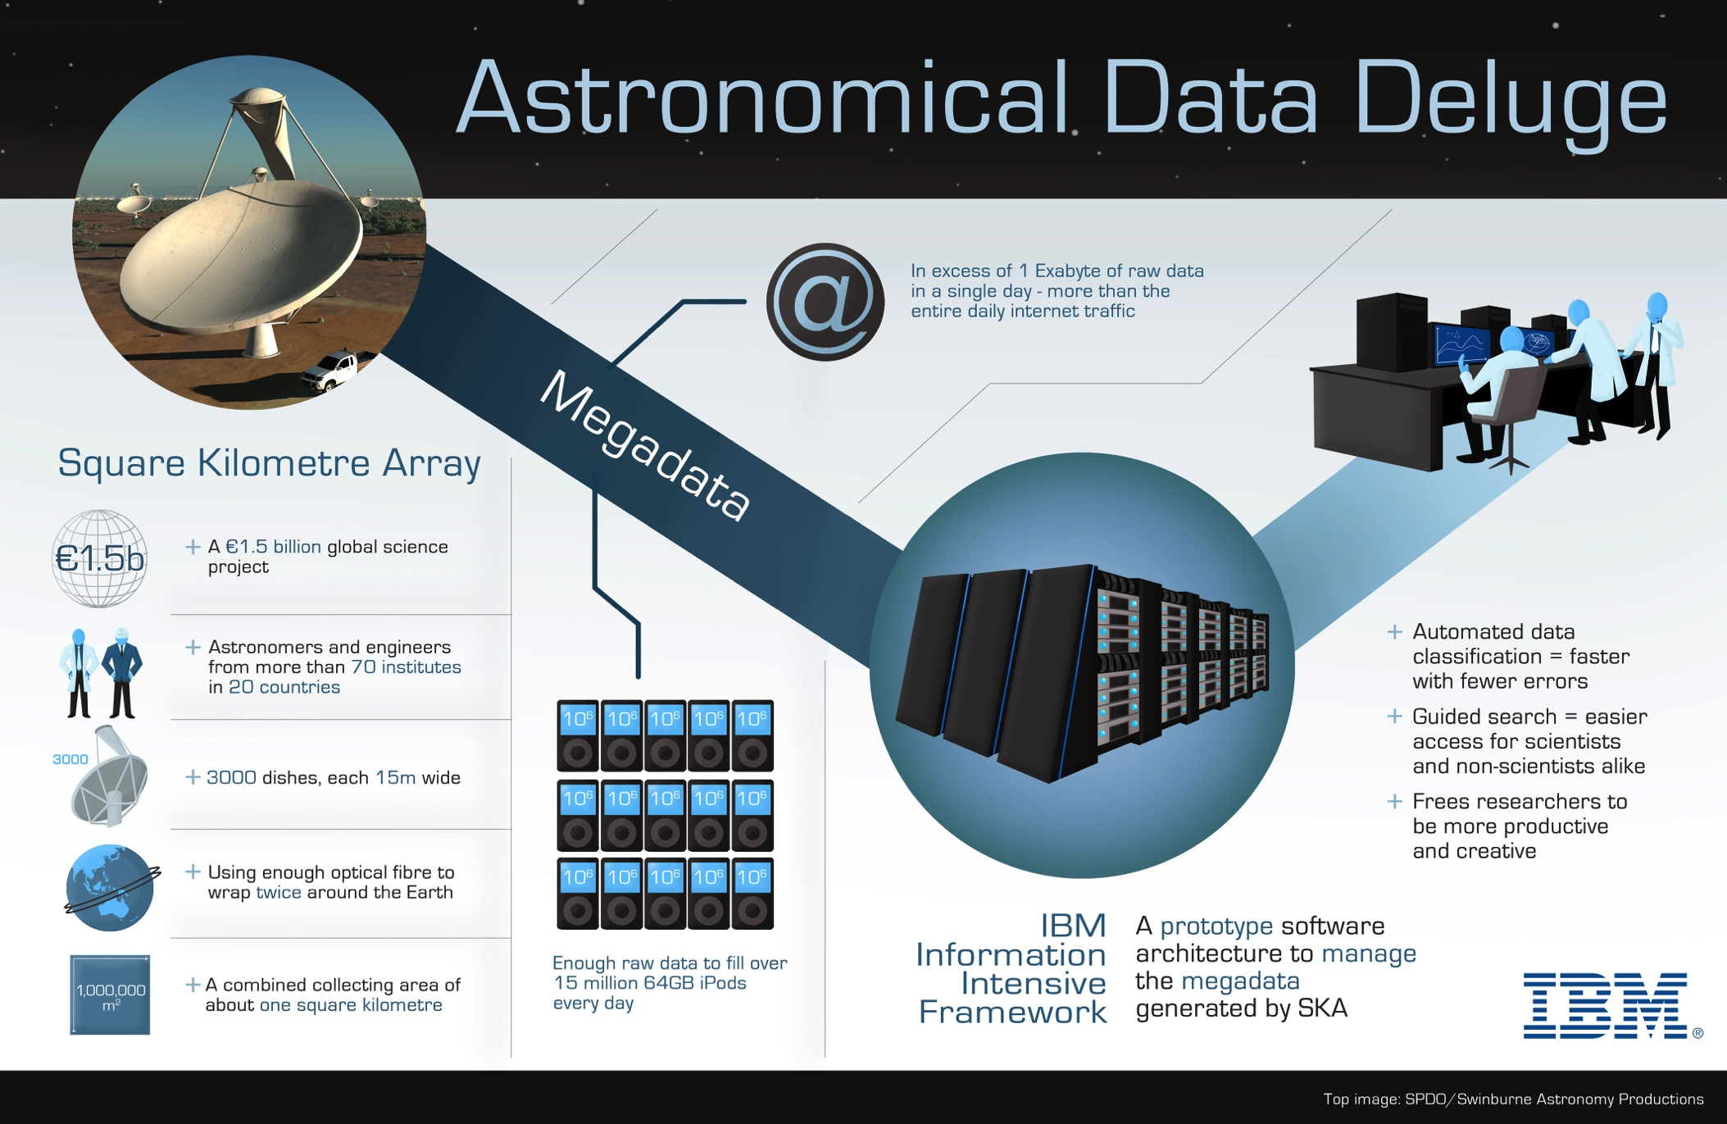
Square kilometer array

Slide 7
Some current Systems
moa.cs.waikato.ac.nz
samoa-project.net
spark.apache.org/streaming
lambda-architecture.net
R’s stream package (clustering only)
(plus /r/streamMoa package)
RapidMiner streams plugin
Weka’s UpdateableClassifier interface

Slide 8
What is stream mining
Online
Learning
Time
series
Data bases
STREAM
MINING
8
Notes:
8

Slide 9
5 Stream Mining Challenges
I: Process examples incrementally
II: Use very limited amount of memory and time to process each example
III: Be ready to predict at anytime
IV: Be able to adapt to change, as input is non-stationary
V: Cope with delayed/limited feedback
9
Notes:
9

Slide 10
2 big questions
Is your input (x) independent and identically distributed (i.i.d.)?
Are your targets (y) independent and identically distributed (i.i.d.)?
10
Notes:
10

Slide 11
Fundamental Assumption in Batch Machine Learning
Training and test data come from the same distribution,
they are both i.i.d.
If not: Evaluations are wrong and misleading.
E.g. Bioinformatics dispute on the (in)adequacy of cross-validation
“The experimental results reported in this paper suggest that, contrary to current conception in the community, cross-validation may play a significant role in evaluating the predictivity of (Q)SAR models.” [Gütlein etal 2013]
11
Notes:
11

Slide 12

The real world is not i.i.d.
PAKDD2009 competition: assess credit card risk
- Training data from 2003
- Public leaderboard data from 2005
- Final evaluation data from 2008
Winners:
#1 was 60th on the leader board
#2 was 9th on the leader board
#3 was 16th on the leader board
12
Notes:
12
12

Slide 13
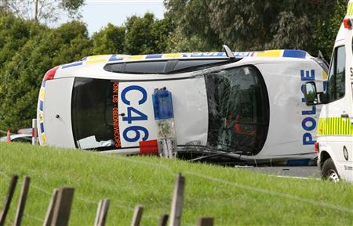
“Demo” New Zealand Road Accident Data 2000-2014
~500000 accidents
~200000 with “Driver 1 had a significant influence”

Slide 14
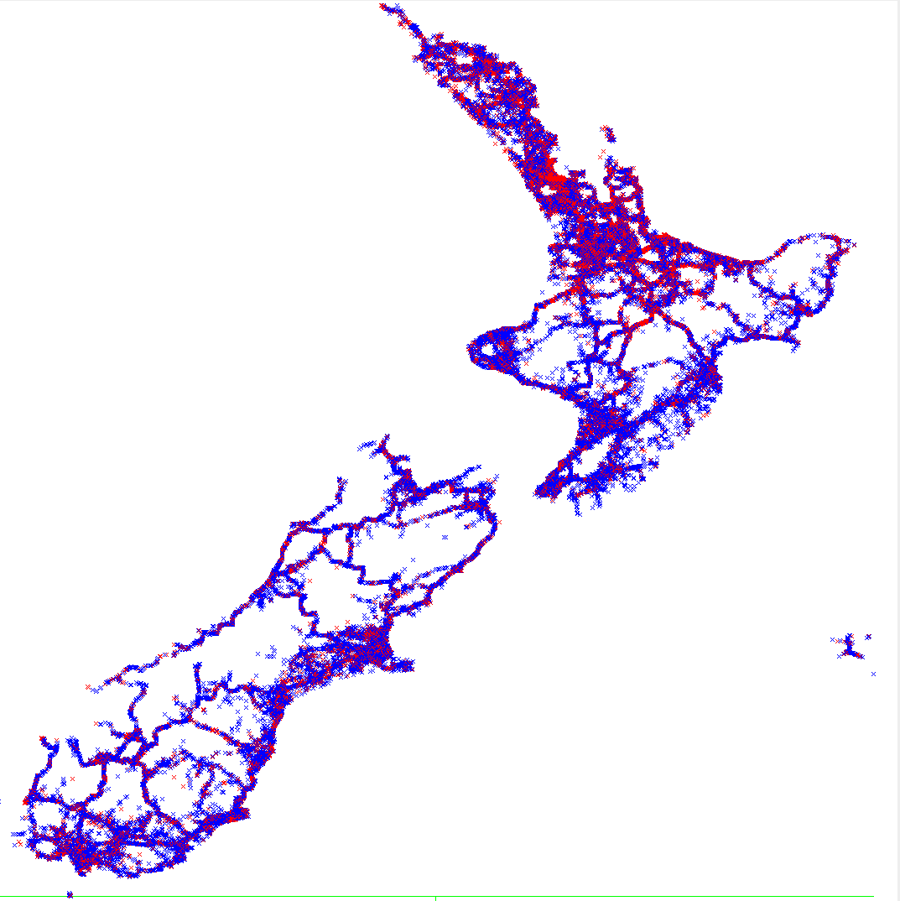
All accidents

Slide 15
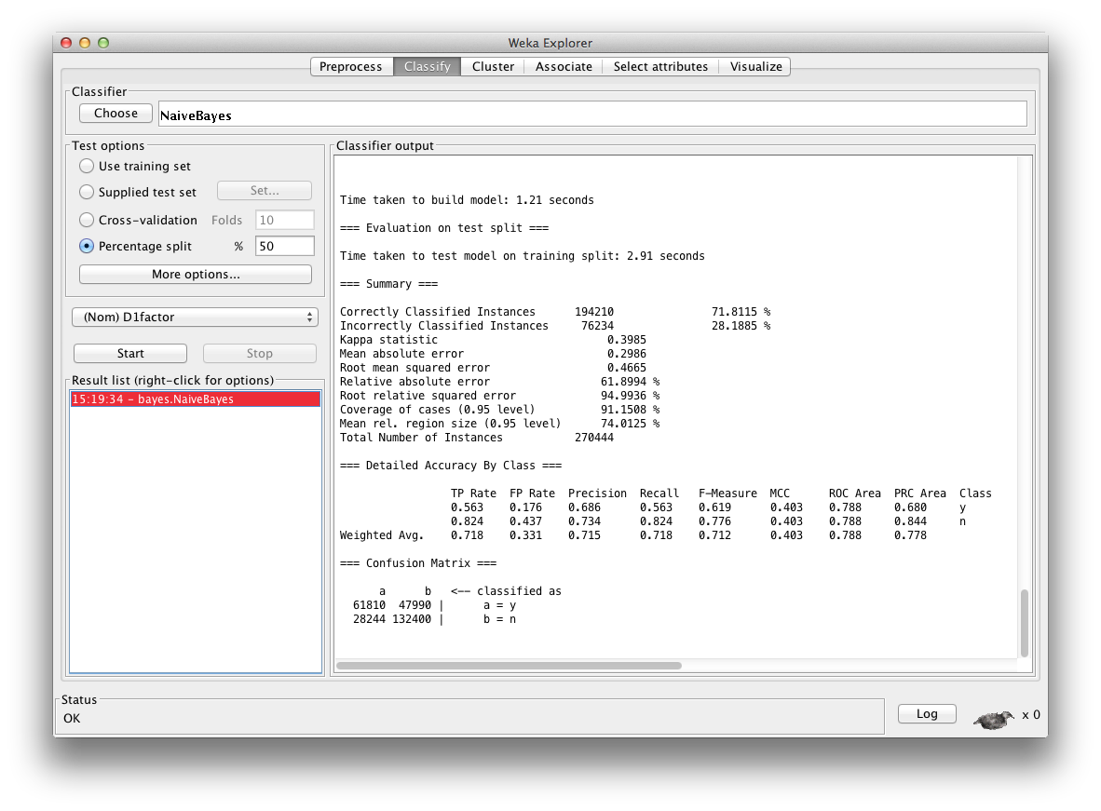
71.81%

Slide 16
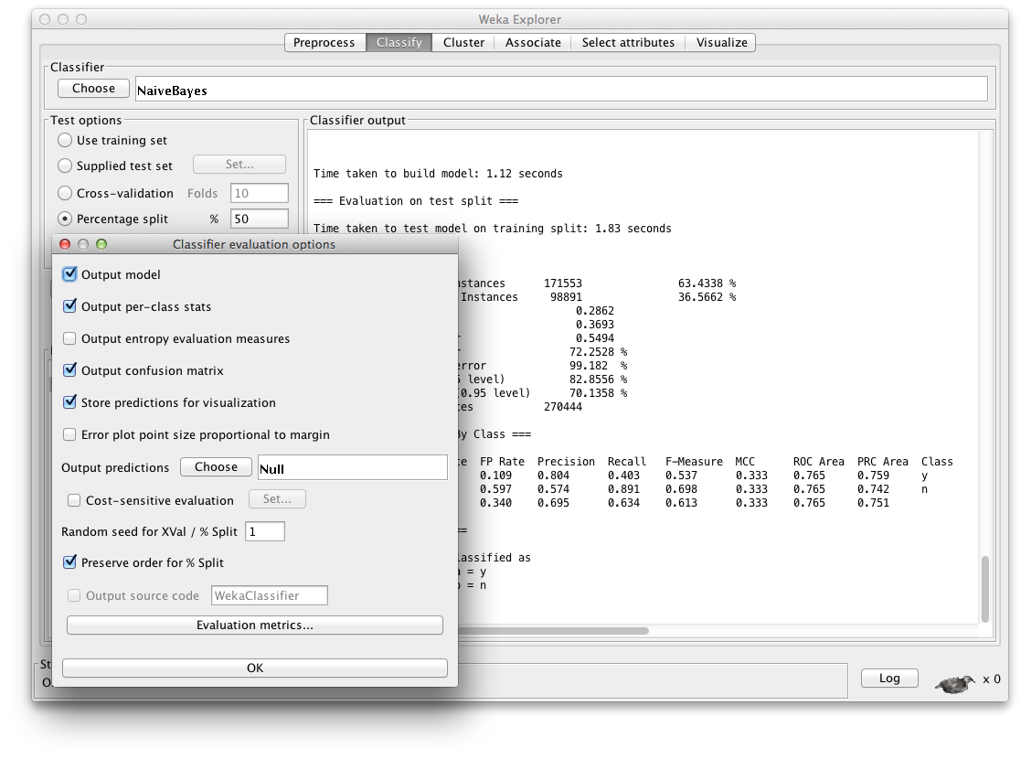
63.43%

Slide 17
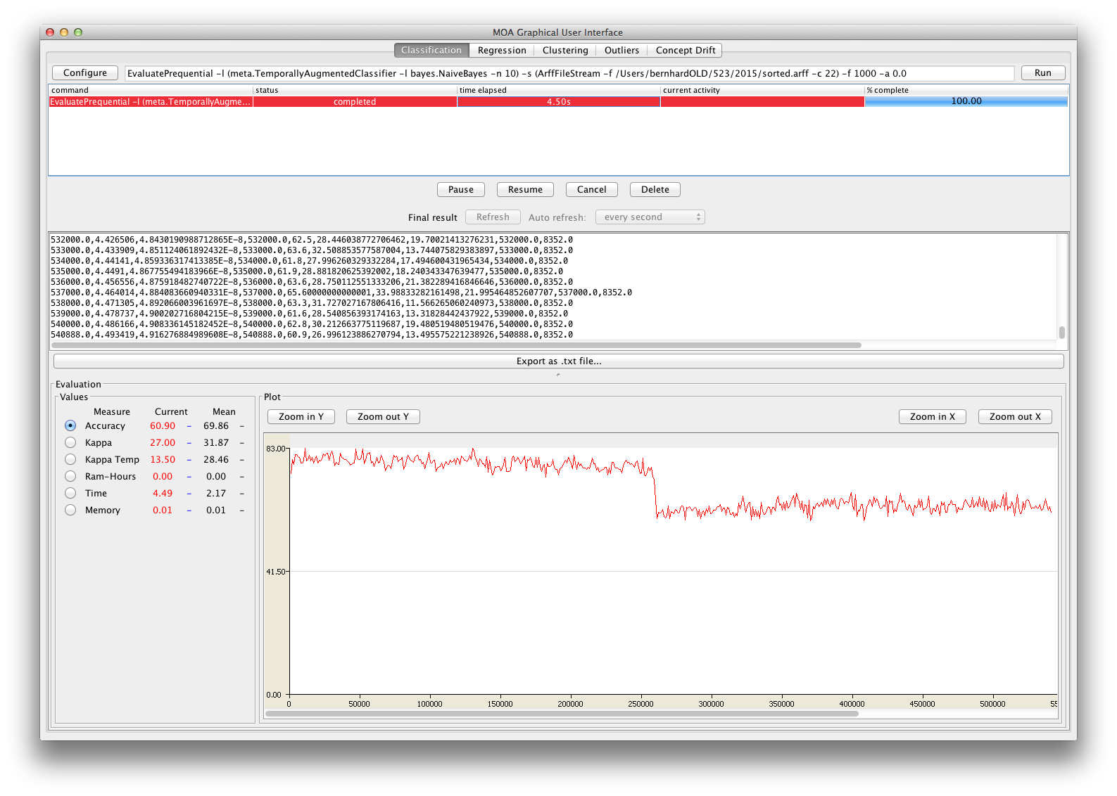
???

Slide 18
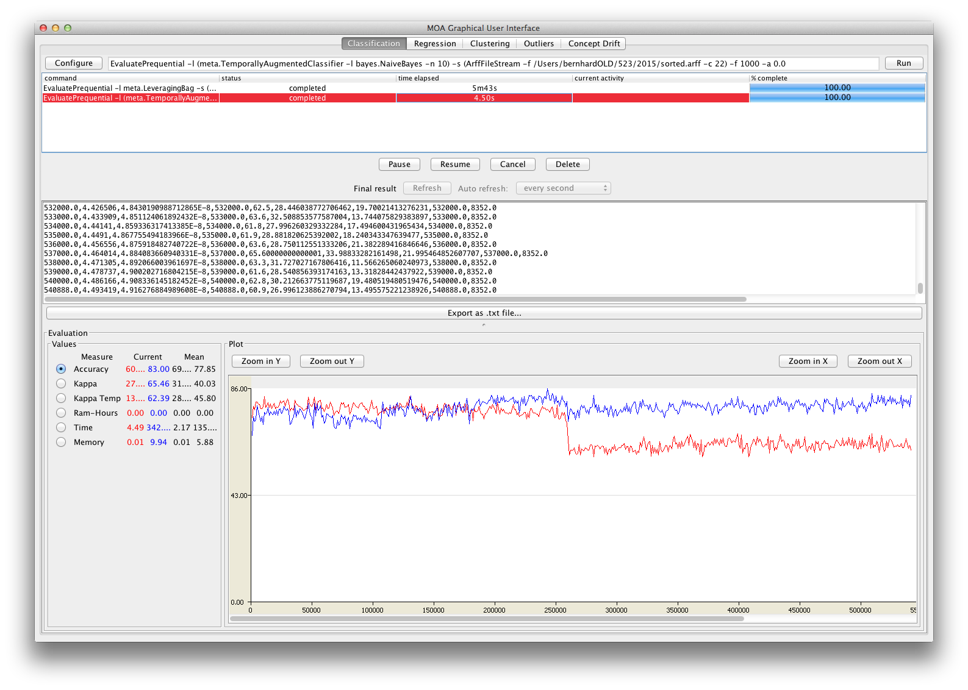
Bagging
With a
Change
Detector
[Adwin]

Slide 19
RTFM ☺
“Driver and vehicle factor codes were not added to non-injury crashes in the areas north of a line approximately from East Cape, south of Taupo, to the mouth of the Mokau River prior to 2007.”

Slide 20
Panta Rhei (Heraclitus, ~500 BC)
Change is inevitable
Embrace it!
[short enough snapshots may seem static, though]

Slide 21
My claim: most Big Data is Streaming
Current, inefficient way to cope:
Regularly (every night) retrain from scratch
Stream mining might offer an alternative

Slide 22
Three standard algorithmic approaches
Re-invent Machine Learning ☺
Batch-incremental
Two levels
Online summaries / sketches
Offline second level, on-demand, or updated regularly
Fully instance-incremental:
Adapted classical algorithm
Genuine new algorithm

Slide 23
Everything is an approximation
Probably true for most of batch learning as well
For streams: being exact is impossible

Slide 24
Sampling
Reservoir sampling:
Collect first k examples
Then with prob k/n replace a random reservoir entry with the new example
Min-wise sampling:
For each example generate a random number uniformly in [0,1]
Only keep the k “smallest”
Comparison?

Slide 25
Sliding window
Easiest form of adaptation to changing data
Keep only last K items
What data structure?
Can efficiently update summary stats of the window (mean, variance, …)

Slide 26
Counting in log N bits
What is the number of distinct items in a stream?
E.g.: IP addresses seen by a router
Exact solution needs O(N) space for N distinct items
Hash sketch needs log(N) bits only ☺
Hash every item, extract position of the least significant 1 in the hashcode
Keep track of the maximum p for any item
N ~ 2^p [Flajolet & Martin 1985]
Why?
How can we reduce the approximation error?

Slide 27
Count-Min sketch
Count occurrences of items across a stream
E.g. how many packets / network-flow
Exact solution: hash-table flow-identifier -> count, high memory cost
Instead: use fixed size counter array [Cormode&Muthukrishnan 2005]
c[ hash(flow)]++
Hash collisions: count is inflated (but NEVER too small, may be too large)
Reduce approx.error: use multiple different hash functions
Update: increment all
Retrieval: report the MIN value
Use log(1/delta) hash of size e/epsilon for err <= epsilon * Sum counts with p=1-delta

Slide 28
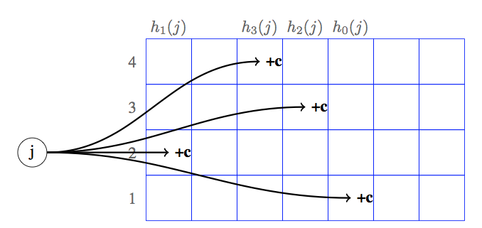
CM example

Slide 29
Count-min cont.
Inspired by Bloom filters
Idea to drop expensive key-info from hashes more generally useful,
E.g. “hashing trick” in systems like Vowpal Wabbit
See http://hunch.net/~jl/projects/hash_reps/index.html for more info

Slide 30
Frequent algorithm [Misra&Gries 1982]
Find top-k items using only n counts: k < n << N
For each item x:
If x is being counted: increment
Else: if a count is zero, allocate it to x, and increment
else: decrement all counts

Slide 31
SpaceSaving algorithm
Interesting variant (Metwally etal 2005):
For each item x:
If x is being counted: increment
Else: find smallest count, allocate it to x, and increment
Efficient data-structure?
Works well for skewed distributions (power laws)

